Slide 1
Language Models

Slide 2
Language Model
ML model that can look at part of a sentence and predict the next word
Eg: Smartphone keyboard
GPT-2 trained on a massive 40GB dataset
Builds on the Transformer model, where it stacks upon more layers
Eg: BERT: uses transformer encoder blocks
GPT-2: built using transformer decoder blocks.

Slide 3
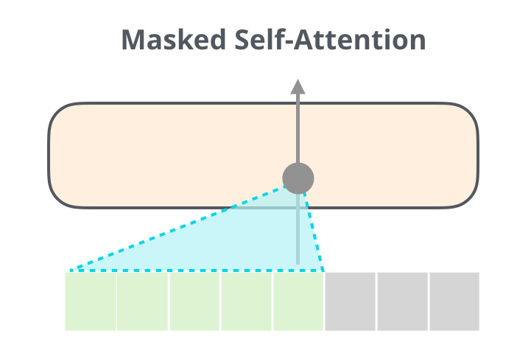
GPT-2
Generates one token as output at a time
When a token is produced, that token is added to the sequence of inputs
That new sequence becomes the input to the model in its next step
Idea called “auto-regression” (made RNNs unreasonably effective)
Uses masked self attention mechanism doesn’t allow to use context of token to the right of token being considered

Slide 4
GPT 2 Architecture
Consists of a stack of Transformer decoders
To run a GPT 2 we can either:
Allow it to ramble by itself
Give it a prompt to have it speak about a certain topic
Model takes one token as input, so only that path is active
Token is processed through the different layers and produces a vector
Vector is scored against model’s vocabulary (50,000 words)
Eg: ‘the’ has the highest probability (taking it as an example)

Slide 5
Sometimes the model can repeat itself in a loop and thus you have to choose the second or third suggested word
It has a parameter: top-k
Use to have model consider sampling words other than the top word
Add output of first step to the input sequence and have it make next prediction

Slide 6
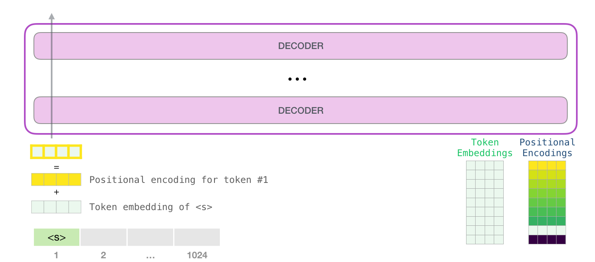
1. Find word embedding of the input word in embedding matrix (start token <s>)
2. Find positional encoding- signal to indicate order of word in sequence to transformer model

Slide 7
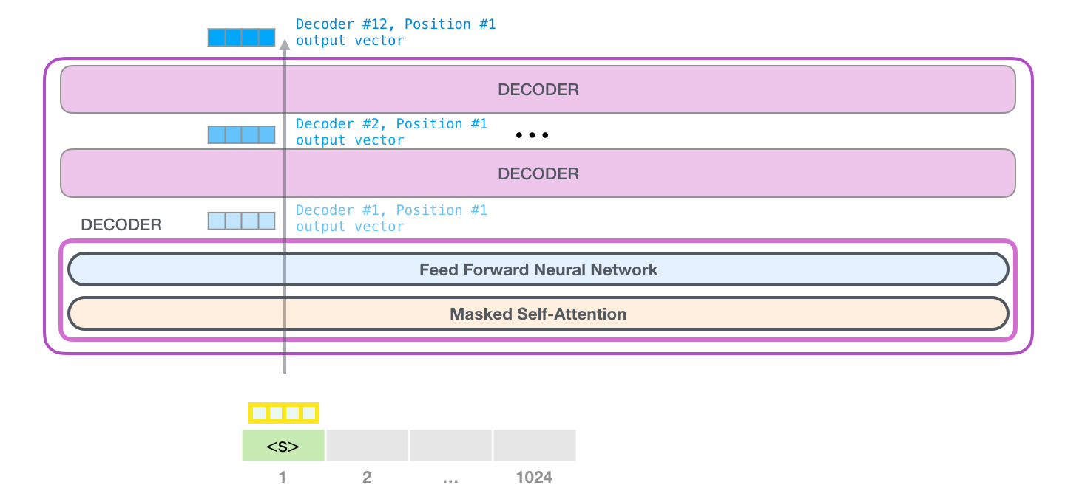
First decoder block passes it through its self attention process and neural network layer
Sends resulting vector to second block
Process is identical in every block but each block has its own weights in self attention and neural network layer

Slide 8
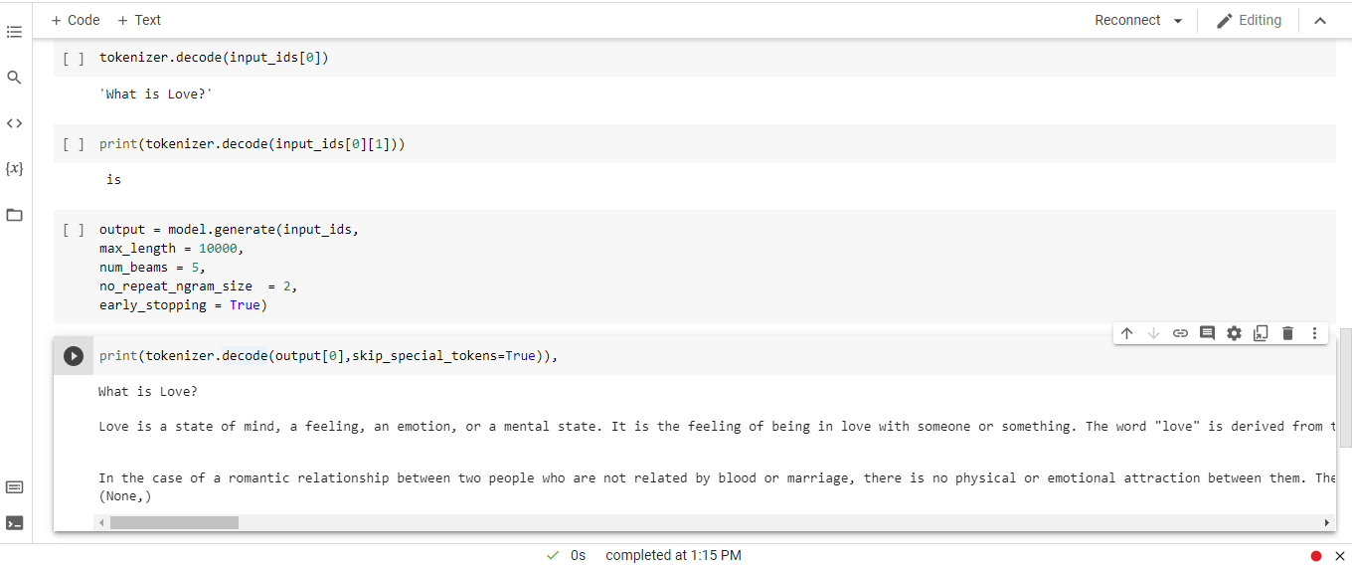
Implementation

